Slide 1
PrEParedness for the Rollout of Effective HIV Prevention among Key Affected Populations in Brazil, Peru, and Mexico The Imprep pROJECT
Valdiléa G. Veloso, MD, PhD
Evandro Chagas National Institute of Infectious Diseases
FIOCRUZ
Rio de Janeiro - Brazil

Slide 2
ImPrEP Team
Principal Investigator: Dr. Valdiléa Veloso, Fiocruz
Principal Investigators in Brazil: Dr. Valdiléa Veloso and Dr. Beatriz Grinsztejn, Fiocruz
Principal Investigator in Peru: Dr. Carlos Cáceres, Universidad Peruana Caetano Heredia
Principal Investigators in México: Dr. Hamid Vega, Clínica Condesa e Dr. Hugo López-Gatell, Instituto Nacional de Salud

Slide 3
Rationale
Concentrated epidemics among MSM and Transgender Women in Latin America due to higher prevalence rates, persistent stigma and discrimination, and poor access to services
Combination prevention is essential to achieve 75% reduction of new HIV infections by 2020 among key populations (90-90-90 targets).
PrEP is a proven highly effective prevention intervention.
Brazil’s and Peru’s experiences in PrEP research:
iPrEX – Brazil and Peru
PrEP Brazil – demonstration project that enrolled 600 MSM and TGW in 5 sites (Rio de Janeiro, São Paulo, Manaus, Porto Alegre)
PREPARADAS – PrEP among TGW, that includes a sub-study on drug interaction between hormone therapy and PrEP

Slide 4
Rationale
The need to generate evidences on PrEP that are specific to the cultural contexts and health systems in Brazil, Peru and Mexico in order to support and inform governments’ decisions in incorporating PrEP as a public health policy.

Slide 5
ImPrEP Project Design
Goal: to contribute to the reduction in HIV incidence among MSM and TGW in Brazil, Mexico and Peru through the inclusion of Pre- Exposure Prophylaxis (PrEP) as a component of HIV combination prevention services.
Outcome: to contribute to increase PrEP uptake among high risk MSM and TGW, in Brazil, Mexico and Peru, contributing to increase PrEP adoption globally.
Funders: UNITAID, Goverments of Brazil, Peru, and Mexico and implementing partners

Slide 6
Planned Studies
Demonstration study on PrEP, that will enroll 7,500 MSM and transgender women in Brazil, Peru and Mexico
Qualitative, quantitative, epidemiologic and economic studies
Among MSM – to assess awareness and willingness to uptake PrEP; and preferences and frequency of HIV testing.
Among Transgender Women– to assess knowledge and willingness to uptake PrEP and preferences and frequency of HIV testing.
Among physicians and health providers - to assess attitudes towards PrEP, and willingness to prescribe PrEP.
Among stakeholders -- qualitative study to assess knowledge and attitudes of key HIV programs, governmental and health services stakeholders regarding PrEP.

Slide 7
Planned Studies
A sero-incidence study among demonstration study’s target populations.
Economic and Mathematical Modelling Studies, including a cost-effectiveness study and other relevant economic studies to inform government’s decision in incorporating PrEP access as part of their public policies on HIV prevention.

Slide 8
Community
The project includes a solid component of community involvement and demand generation with full participation and leading role of the MSM and TGW communities.
Community Advisory Boards at project-level and at each participating country-level.

Slide 9
Generate and disseminate evidence on PrEP for scale-up and South-South cooperation
Development of the Regional Exchange Platform on PrEP and a Working Group on Drug Licensing and Costing
Publication of special issues in scientific journals to disseminate results of PrEP studies developed in the region

Slide 10
PrEP Demonstration Study
Multi-site prospective, open-label, demonstration study
7,500 participants (3,000 in Brazil; 3,000 in Mexico; 1,500 in Peru)
All participants will receive comprehensive HIV prevention services
Daily oral PrEP
Assessment of patterns and correlates of PrEP uptake and adherence through: self-reporting, pharmacy dispensation data measurement of blood drug levels (using DBS)
Sexually Transmitted Infection diagnosis – Molecular testing

Slide 11
PrEP Demonstration Study
Assessment of patterns and correlates of PrEP uptake and adherence will include self-reporting, pharmacy data on drug dispensation, and dried blood spots (DBS) tests on drug level
Sexually Transmitted Infection diagnosis will be conducted utilizing PCR.
Study Drug:
In Brazil: purchased by the Brazilian MoH
In Mexico: donated by Gilead
In Peru: purchased with project funds

Slide 12
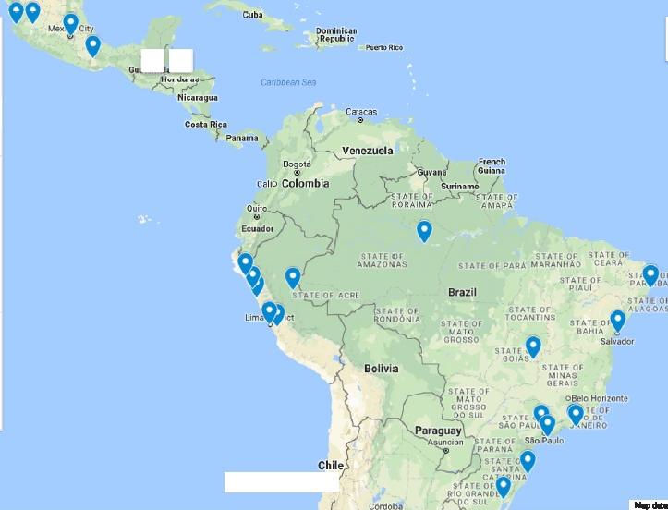
ImPrEP - Demonstration Study
Peru - 10 sites
Mexico – 8 sites
Brasil – 15 sites

Slide 13
The Brazilian Experience on PrEP
From Clinical Trial to Public Policy

Slide 14
Thank you!
valdilea.veloso@ini.fiocruz.br

